Slide 1

Computer Forensics
Windows Operating System Artifacts
Dr Diane Gan

Slide 2
Introduction
Dates and time
Windows OS Artifacts
Windows 7
Some differences and similarities - Win 7, Vista and XP
Artifacts that have not changed
Default folder structures

Slide 3
Dates and Times
Storage formats vary
Local time
GMT – universal time or Zulu time
Windows file attribute dates and times
MAC times – media access control times
Depends on files system in use
Is it local time or GMT?
FAT – stored in local time
NTFS – stored in GMT
Notes:
Ref: EnCase Certified Examiner Study Guide by S. Bunting and W. Wei
ISBN 0-7821-4435-7

Slide 4
NTFS – uses 64 bit date and time stamp
Displayed to user with local time zone offset
Computer was seized in a one Time Zone – may have been configured in another!
Or may be deliberately configured incorrectly
Unix
1st Jan 1970 – GMT 00:00:00
in seconds
32 bit integer
Windows
1st Jan 1601 – GMT 00:00:00
100 nanosecond intervals
64 bit integer
Notes:
Unix
1st Jan 1970 – GMT 00:00:00
in seconds
32 bit integer – 4,294,967,296 = max integer
Will last only until 2nd Dec 2030
Windows
1st Jan 1601 – GMT 00:00:00
100 nanosecond intervals
64 bit integer – 18,446,744,073,500,000 = max integer
Will last 58,000 years!

Slide 5
Windows OS Artefacts
Created by OS
Stores information about the user, their actions and preferences, etc
Log-files
Link files
Passwords
Caches
History
Swap files
Recycle bin
Deleted files
Recently used files, etc

Slide 6
Differences and similarities
Many Win 7 system related objects are the same as in Vista
Major differences
“jump lists”
The kernel has changed – now handles more function calls than Vista’s kernel could
File system is the same for Win 7, Vista and XP giving backwards compatibility

Slide 7
Unchanged
EFS – Encrypting File System
Shadow copy
Thumbcache – same as Vista but changed from XP
Core system-created registry files:
SAM, SYSTEM, SOFTWARE, SECURITY
still found in system_root
Windows\System32\config
Notes:
EFS
Windows 7 uses the same hybrid system of protecting file data but there have been some updates to the cryptographic application used to encrypt/decrypt the data
Shadow copy
Functionality remains the same as well as the location of the backed up file data
Thumbcache
Can be found in the same location as in Vista but there are minor changes to the internal database

Slide 8
Windows 7 and Vista use the Windows Vista Directory Junctions
Used to improve the user roaming capability
Users may use multiple computers to access and alter their data profiles
Windows XP system there is a wait as the profile data is transferred to that location
Windows XP data (roaming) profile consists of the following folders:
Application data
Desktop
My Documents
My Pictures
Start Menu
Missing is Cookies and Favorites
Notes:
Windows 7 and Vista use the Windows Vista Directory Junctions feature which improved the user roaming capability first seen in the Windows 2000 and XP systems. This caused the change in the naming conventions and structure in the user folders and file system to accommodate these improvements.
In a business environment users may use multiple computers to access and alter their data profiles. When a user logs on to a Windows XP system from a workstation or laptop, there is a wait as the profile data is transferred to that location. The Windows XP data profile consists of only the following folders:
Application data
Desktop
My Documents
My Pictures
Start Menu
In order to cut down the amount of profile data that is transferred each time a user logs in to a Windows XP system, the roaming profile does not include other important folders such as Cookies or Favourites

Slide 9
Windows 7 uses a client-side technology called Folder Redirection
Allows logging on at any location
Also access to stored data no longer on the local machine
Viewing data at the hex level reveals the pointer to the target location used to send and receive data calls
Still see the folders found in XP
In Win 7 the important folders within each user profile folder are found in:-
AppData and Documents
Of great forensics interest within each profile are:
AppData (formerly Application Data)
Documents (formerly My Documents).
Notes:
Windows 7 uses Client-side technology called folder redirection which allows the systems administrator to change the target location of predetermined folders located in the user’s profile. Now data does not have to be downloaded and then uploaded and copied back to the server when the user logs on or off from different computers. The redirection allows logging on at any location and also allows access to data to the stored data no longer on the local machine.
Systems administrators can now set this up on Windows XP and 2000 machines using the Folder Redirection Group Policy snap-in. As many as 10 folders can be redirected from the user profile rather than the five folders originally stored by XP.
The Users folder includes many of the familiar folders found in Documents and Settings folder (XP). In Win 7 these contain reparse points. The two folders of great forensics interest within each profile are: AppData (formerly Application Data) and Documents (formerly My Documents). The Favorites folder is the same as in XP and is in the root of the username folder. This is where Internet favorites for IE are stored.
The All Users folder in XP stores common user data that is available to all users on the local system. Win 7 stores this profile in the folder off the root volume (typically C:\) in a folder called ProgramData, allowing access to all users and applications on the system.

Slide 10
Reparse Points
XP
Vista and Windows 7
Junction | Links to this location
<username>\Application Data\ | \<username>\AppData\Roaming
<username>\Cookies | \<username>\AppData\Roaming\MicroSoft\Windows\Cookies
<username>\Local Settings | \<username>\AppData\Local
<username>\My Documents | \<username>\Documents
<username>\Start Menu | \<username>\AppData\Roaming\MicroSoft\Windows\Start Menu
<username>\PrintHood | \<username>\AppData\Roaming\MicroSoft\Windows\Printer Shortcuts
<username>\Recent | \<username>\AppData\Roaming\MicroSoft\Windows\Recent
<username>\SendTo | \<username>\AppData\Roaming\MicroSoft\Windows\SendTo
Notes:
The AppData folder contains three sub-folders
Local (formerly Local settings)
LocalLow
Roaming
The Local folder also contains a Microsoft folder which stores Internet cache and History
The cookies folder is synchronised with the profile stored on a domain network (if used) and is not wiped when the temporary internet history is deleted.
The table above contains the new folder locations. Legacy folders have a pointer in them from junctions created within Vista and Win 7. According to MS the pointer feature is used to improve ease of navigation by simplifying the extensive nesting folders and to improve the distinction between application data and user-stored data.

Slide 11
Unchanged user artifacts
Registry
Shadow copy
Folder/file structures
Link files
Encrypting File System (EFS)
Spool files (except for the .SHD file format)
Alternate data streams (unchanged from Vista)
$Recycle (between Vista and Win 7)
Thumbcache (between Vista and Win 7)

Slide 12
Recycle Bin (Windows XP)
Most deleted files pass through here
Can restore a file to the original location
Or delete it
Can you by-pass the Recycle bin?
What happens if you do?
Name of the file in the Recycle bin?
[D] [original drive letter] [index number].[original file extension]
Example – DC1.doc for the first file in the bin
Where is the original name?
In a hidden file INFO2 (database file)

Slide 13
Windows XP
File c:\Myletter.doc
If we restore the file the INFO2 entry is not deleted
Nksdbn fdgkjdk vcvb uibfn k f akj Jhcsd
Wfoowjfojn fskf
XP starts its index at 1
delete
DC1.doc
$MFT
Myletter.doc
Recycle bin
X
INFO2
IN=1 c:\Myletter.doc date + time
Date and time of deletion
Index number (IN)
File marked as over-written – why?
Notes:
If we want to restore a deleted file then the OS must store its original location – which drive, which folder, etc.
Deleted files
EnCase reports them as overwritten because the starting cluster is in use by the new file name created in the Recycle bin.
Try deleting some files and then looking at them using FTK or EnCase.

Slide 14
Emptying the bin (Windows XP)
MFT entries are marked – available
INFO2 records
Drive letter of the path is removed
Reset to 20 byte header
Entries are 800 bytes
Still see INFO2 records in file slack
User restores file
Record created in MFT – original location
Recycle bin entry is marked as deleted
In INFO2 – first char becomes 00h
Notes:
When the file is removed from the bin,

Slide 15
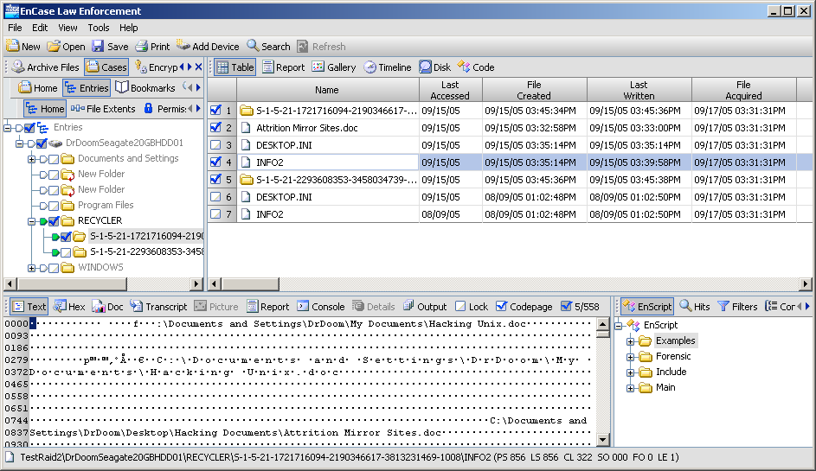
SID
INFO2
Notes:
SID = users security ID
Forensically equivalent to throwing rubbish away with your name and social security number on it!

Slide 16
Owner of files in Recycle Bin
Win NT/2K/XP/2003 – added the users SID
Is this useful to our investigation?
Check the last modification to the INFO2 file
What does this tell us?
Vista recycle bin – no INFO2 file
Recycle bin > $Recycle.bin
A user associated with a SID
Can manually resolve using Security Accounts Manager (SAM)

Slide 17
$Recycle.Bin (Windows 7)
INFO2 file - replaced by file pairs - $R and $I
Track the recycled files
$I administrative file – has a random name after $I – e.g. $ILAIZL.gif
keeps the original extension
Tracks original path and file name in Unicode
Recycled time of the file
File size is limited to 544 bytes
$RLAIZL.gif is the actual (renamed) deleted file
User can configure the size – (5% to 9% of drive)

Slide 18
Path for the $Recycle.Bin is at the root of Every volume
Even portable devices
Windows 7 creates a SID folder for each user who authenticates on the system
Removable drives can have a Recycle bin and a $Recycle.Bin
This means it has been on two types of computer
Multiple rebuilds will generate new SIDs
$I file – offsets 16 to 23 = 64 bit Windows date and time stamp = when the file was recycled
Offset 24 = path and file name begin

Slide 19
$Recycle.Bin preferences are per user based
NukeOnDelete = bypass the bin = 1
Use the bin = 0
In NTUSER.DAT go to:-
Software\Microsoft\Windows\CurrentVersion\BitBucket
On removal of individual files - the $MFT entry is wiped
File data runs on the drive are overwritten (saltedsalt)
When a folder is removed from the Recycle.Bin the $MFT data for the folder is overwritten
But file data remains on the disk
Data for the filenames, dates and times can still be seen
After a reboot this data is overwritten - unrecoverable

Slide 20
After removal from the $Recycle.Bin the chances of recovering the original file are not good
Keyword searches may provide evidence
Page files copies
Memory duplication
Local history
Pulling the plug
Other places to look - Shadow copy
Recent file information in the pagefile isn’t deleted when the power is removed to prevent Shutdown
Notes:
The likelihood of recovering data after the user removes it from the Recycle Bin is generally unlikely. However there are other locations where data and evidence of files exists in the OS.
Keyword searches may yield evidence of the data. Data is written in memory and may subsequently be written to the hard drive. Evidence can be found in the pagefile by keyword searches.
Memory often duplicates data in the pagefiles. Multiple references to the same file may exist in the deleted pagefiles, also discoverable by keyword searches.
Pulling the plug on a Windows 7 system can have the added benefit of maintaining recent file information in the pagefile, which isn’t deleted on a hard shutdown.

Slide 21
Desktop folder
Located in the root user folder
Majority of files and folders are due to user activity
Typically shortcuts, applications or docs
Other desktop objects
Recycle Bin
Computer
Internet Explorer
Users place frequently accessed items here
Files come from three sources
Registry
All Users desktop folder
User’s Desktop folder

Slide 22
As user first logs on – Windows creates a unique artefact
In Documents & Settings (XP) – name of user
In Windows 7 and Vista - User/username/
Called – root user folder
Identifies the user by their logon name
Another significant file is NTUSER.DAT
Contains
File creation = when they first logged on
Last update = when they logged off
Recent folder – what the user has created or modified

Slide 23
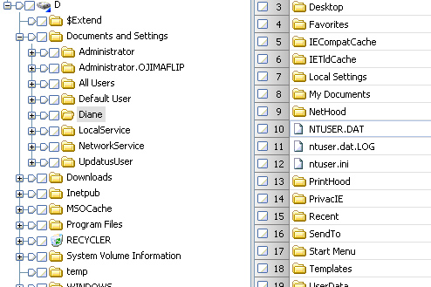
All Users – should also be investigated
Not user specific – more global
Each user gets a specific named account folder
Root named after the user’s login name
NTUSER.DAT
Specific settings
for the user
Updated when the
user logs out
XP view

Slide 24
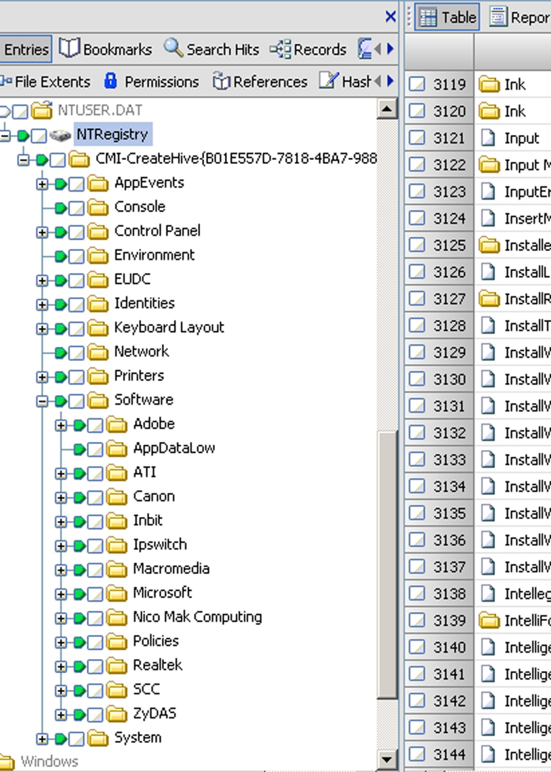
NTUSER.DAT
Software
Microsoft
NTUSER.DAT
Software
Microsoft
Most recently used (MRU)
Mounted and mapped drives
Search history (IE)
For Win XP to Win 7
Notes:
Data is taken from the NTUSER.DAT of the logged in person at startup. This file tracks each user’s configurations, settings, preferences, behaviours and other associated activity for that user. It may also contain logon and password information, most recently used documents, mounted and mapped drives and search history through Internet Explorer browsers.
RecentDocs shows a compilation of the documents from all the subkeys in numerical format. The MURList will show the sequential order of access to the documents.

Slide 25
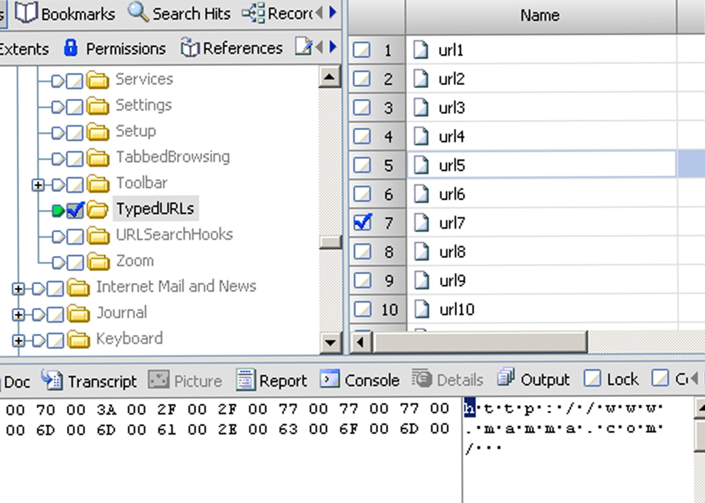
NTUSER.DAT\Software\Microsoft\Internet Explorer\TypedURLs
Errors in typing will also be tracked
tracks up to 25 URLs
not updated until IE browser has been exited appropriately
forensically important because it demonstrates user behaviour
Notes:
TypedURLs is a registry entry that tracks addresses that were either typed or pasted into the IE browser’s address. It tracks up to 25 URLs with the latest (smallest number) on the top. The numbers can get out of order, as the system does not re-enter duplicates. Errors in typing will also be tracked, if they are followed by Enter. Important – the TypedURL entry is not updated until IE browser has been exited appropriately either by clicking shutdown x or by clicking File > Close. If a catastrophic shutdown occurs the data will be lost with the memory.
TypedURLs are forensically important because it demonstrates user behaviour in logging actual data typed or cut and pasted, rather than accidental redirects. The behaviour of the application continues to be the same from IE6 to IE8 and from Windows XP to Windows 7.

Slide 26
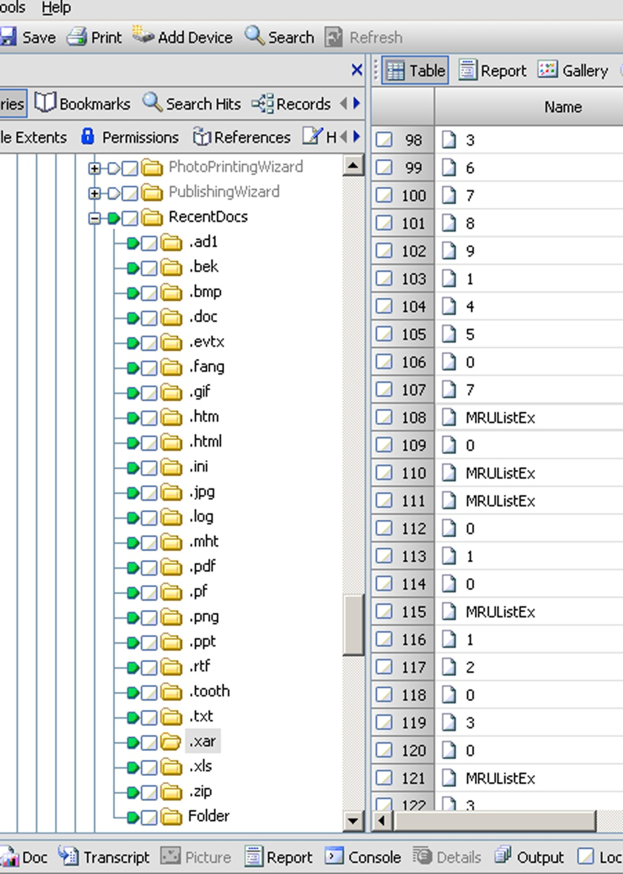
NTUSER.DAT\Microsoft\Windows\CurrentVersion\Explorer\RecentDocs
RecentDocs
Stored by extension
Stores the last 10 of each extension type (0-9)
Creates new extension subkey if new file type
Notice MRUListEx
Lists chronological order of access
Notes:
Each file extension has its own subfolder to display the last 10 documents of that extension that were opened. The information is stored in a numerical format from 0 to 9.
Clicking the RecentDocs subkey will show a compilation of the documents from all subkeys in numerical format. The MRUlist value will show the sequential order of access to the documents.
Notice the MRUListEx value at the top of the value list. This is how the operating system can determine for autocomplete drop-downs which doc was the last accessed. It lists the chronological order of access.

Slide 27
RunMRU
Maintains list of all values typed into the Start menu > Run box
Most recently typed are listed first – in MRUList
In clear text
May even show access to remote systems
Also applications and files on removable storage
Software\Microsoft\Windows\CurrentVersion\Explorer\RunMRU
Notes:
Ref – more on Common Dialog MRU lists at http://support.microsoft.com/kb/322948

Slide 28
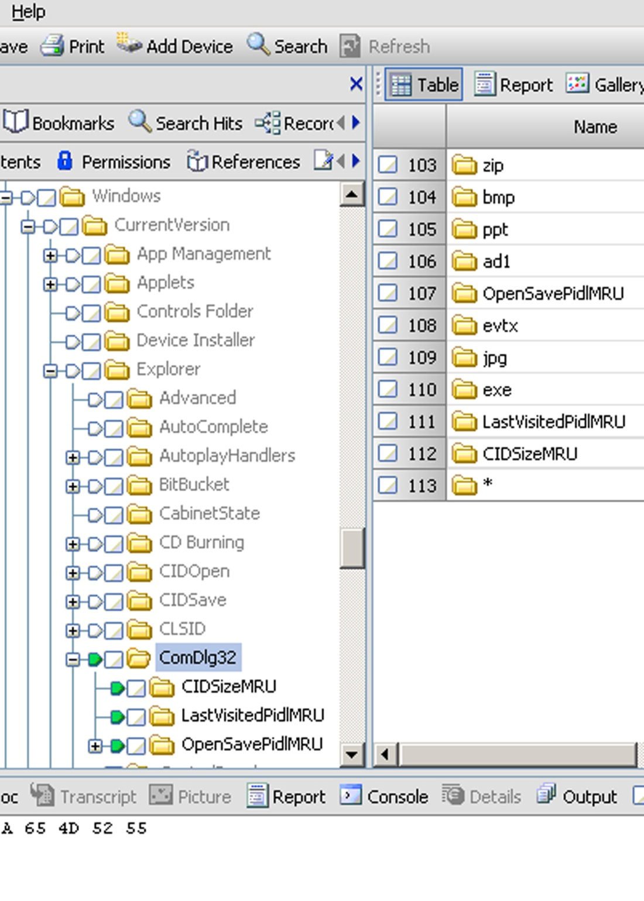
NTUSER.DAT\Microsoft\Windows\CurrentVersion\Explorer\ComDlg32
Common Dialog
Tracks user behaviour for Open and Save As
Recorded here if a program uses Windows standard dialog box to access documents
In Vista and Win 7 more binary data is stored here
In Win 7
CIDSizeMRU
FirstFolder
LastVisitedPidLMRU
LastVisitedPidLMRULegacy
OpenSavePidLMRU
Notes:
The ComDlg32 subkey, short for Common Dialog, tracks user behaviour as it pertains narrowly to Open and Save As dialog boxes for Windows utilities.
If an application is programmed to use the Windows standard dialog box to access documents, it will be recorded here. If an application is using its own proprietary call for a dialog box, document access will not appear here. With the release of Windows 7, modifications were made to the registry entries incorporated here.
In Vista and Windows 7 more binary data is stored in this subset set than in earlier versions. Most of the binary data is deposited for unknown reasons, however, the files and applications are still listed and they are important items of forensics value.
In Windows 7 five subkey sets are stored that archive information regarding the use of the open/Save dialog box.
CIDSizeMRU – tracks applications used to access files
FirstFolder – introduced in Windows 7 – stores default program paths – shows what was accessible
LastVisitedPidLMRU – tracks 64 bit applications that are used to open doc through Open/Save dialog box
LastVisitedPidLMRULegacy – new to Win7 – stores references to 32-bit applications
OpenSavePidLMRU – of most interest – references to individual files accessed by the user
Due to the different functions being tracked by the LastVisitedPidLMRU (application launch through Open/Save) and the OpenSavePidLMRU (application MRU), the data can’t be correlated between the two keysets. Also due to the unique nature of using just the Windows Save As dialog box as a trigger, these values can’t be consistently correlated with the RecentDocs subkey values. They are mainly indicative of their narrow function of use with the Save As dialog box.

Slide 29
NTUSER.DAT\Microsoft\Windows\CurrentVersion\Explorer\ComDlg32
CIDSizeMRU – tracks applications used to access files
FirstFolder – introduced in Windows 7 – stores default program paths – shows what was accessible
LastVisitedPidLMRU – tracks 64 bit applications that are used to open doc through Open/Save dialog box
LastVisitedPidLMRULegacy – new to Win7 – stores references to 32-bit applications
OpenSavePidLMRU – of most forensics interest – stores references to individual files accessed by the user
Using only the Windows Save As dialog box as a trigger, these values can’t be consistently correlated with the RecentDocs

Slide 30
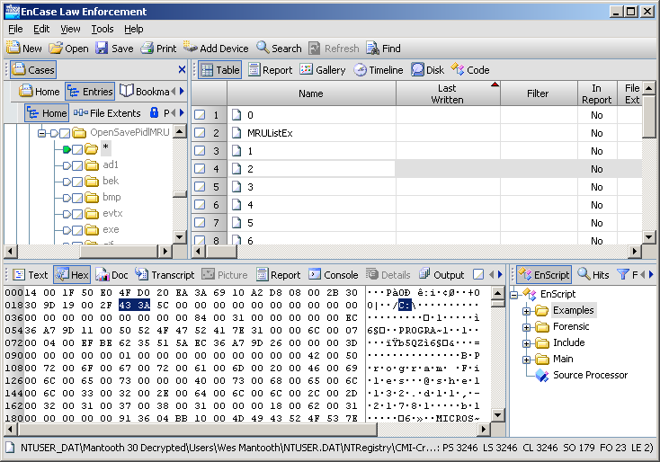
OpenSavePidLMRU
At offset 23 – you can see the drive letter
Notes:
Probably the most important forensically is the OpenSavePidLMRU. It contains references to individual files accessed by the user. This obviously depends on the Microsoft Open/Save dialog box. This includes Microsoft products such as Word, Excel and Powerpoint. It is similar in nature to RecentDocs, as the MRUs are tracked on an extension basis. Each file that meets the archives criteria for storage will be sent to a subkey of its extension. If that extension is being used for the first time a new subkey will be created for that extension.
By default it stores the last 20 items (0 to 19 decimal) in the value name and uses hexadecimal pointers to the MRUListEx. However, several unusual characteristics display inconsistencies regarding where a particular document is stored. The type of data seen in the values is somewhat dependent on the location of the document. For example, if a document opened or saved were on an external or secondary drive then we would be able to see this at offset 23 (offsets 23 – 25). The path is shown in ASCII and Unicode. The document name appears at the end of the variable-sized values.
The ComDlg32 subkey, short for Common Dialog, tracks user behaviour as it pertains narrowly to Open and Save As dialog boxes for Windows utilities.

Slide 31
Link Files
Shortcut files - extension - .lnk
Used throughout Windows – fundamental to the point-and-click GUI environment
Created by OS and by users
Entries drop off the list if they are not used
Each time a Link file is used it is modified
Contents of link file
Complete path to target file
File size (bytes)
MAC time stamps
Only tells us the last time it was opened
Notes:
Link files are ubiquitous throughout Windows
OS creates many link files by default when you install a particular version and service pack
Desktop – default installation of icons
User opens a doc – a link file is created in the Recent folder (has users login name)
Link files have MAC time stamps – significance – if a user installed a program on one day and at a different time created a link file – then this shows that the user was aware of the program and went out of their way to make access easier.
If there is no shortcut for a new file, then the systems creates one. If one exists then the system updates the existing link file (dates and time, etc).

Slide 32
Recent Folder
Link file
Recent Folder
Afile.doc.lnk
O
S
Hksdk akljalkfn alkdfjla alkjlfkjla laklkjlklkad aejfhjh
User opens a new doc
Afile.doc
Checks MAC times to determine the most recent link
Hksdk akljalkfn alkdfjla alkjlfkjla laklkjlklkad aejfhjh
displays the last 15 documents but can contain hundreds of link files
Does this help us?
User re-opens document later
Notes:
Recent Folder
When a user opens a document a link file is automatically created in the Recent folder
The Recent folder is located in the root user folder.
If the same document is reopened later then the link file is updated
The Recent folder contains only link files
Windows checks the MAC times of the “link” file to determine the most recent
Windows displays the last 15 documents opened but the Recent folder can contain hundreds of link files.
Recent folder gives us:- a time line
types of files accessed by user
location of the files

Slide 33
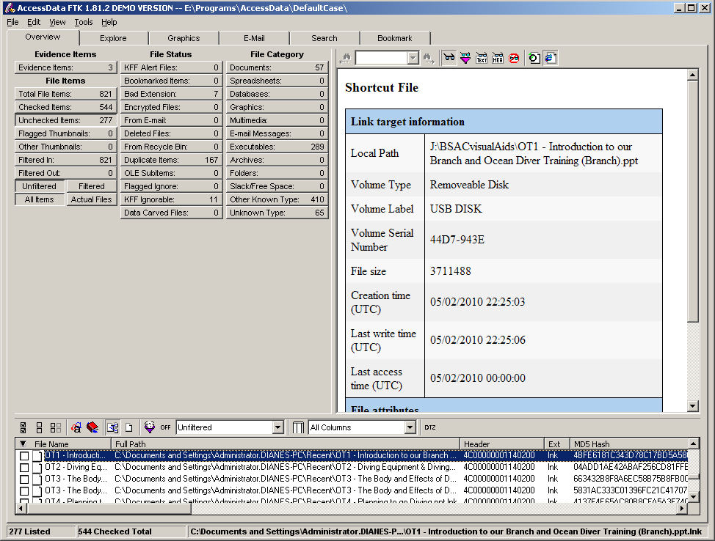
Windows XP
Offset 28 bytes
MAC time stamps
36 bytes
44 bytes
Recent Folder
Unique header
Notes:
Link files
Unique header \x4c\x00\x00\x00\x01\x14\x02
MAC times are listed in the following order:- time created
last accessed
last written
For Vista – last accessed time stamp is disabled - default

Slide 34
Recent list
In Windows 7 they are in
User\username\AppData\Roaming\Microsoft\Windows\Recent
Lnk files are larger than in XP
Different information is displayed in different types of links
e.g. MAC addresses, NETBOIS names will be present if the target file is stored on an NTFS partition
Windows 7 LNK files contain Shell32 info, ASCII and Unicode – ongoing research

Slide 35
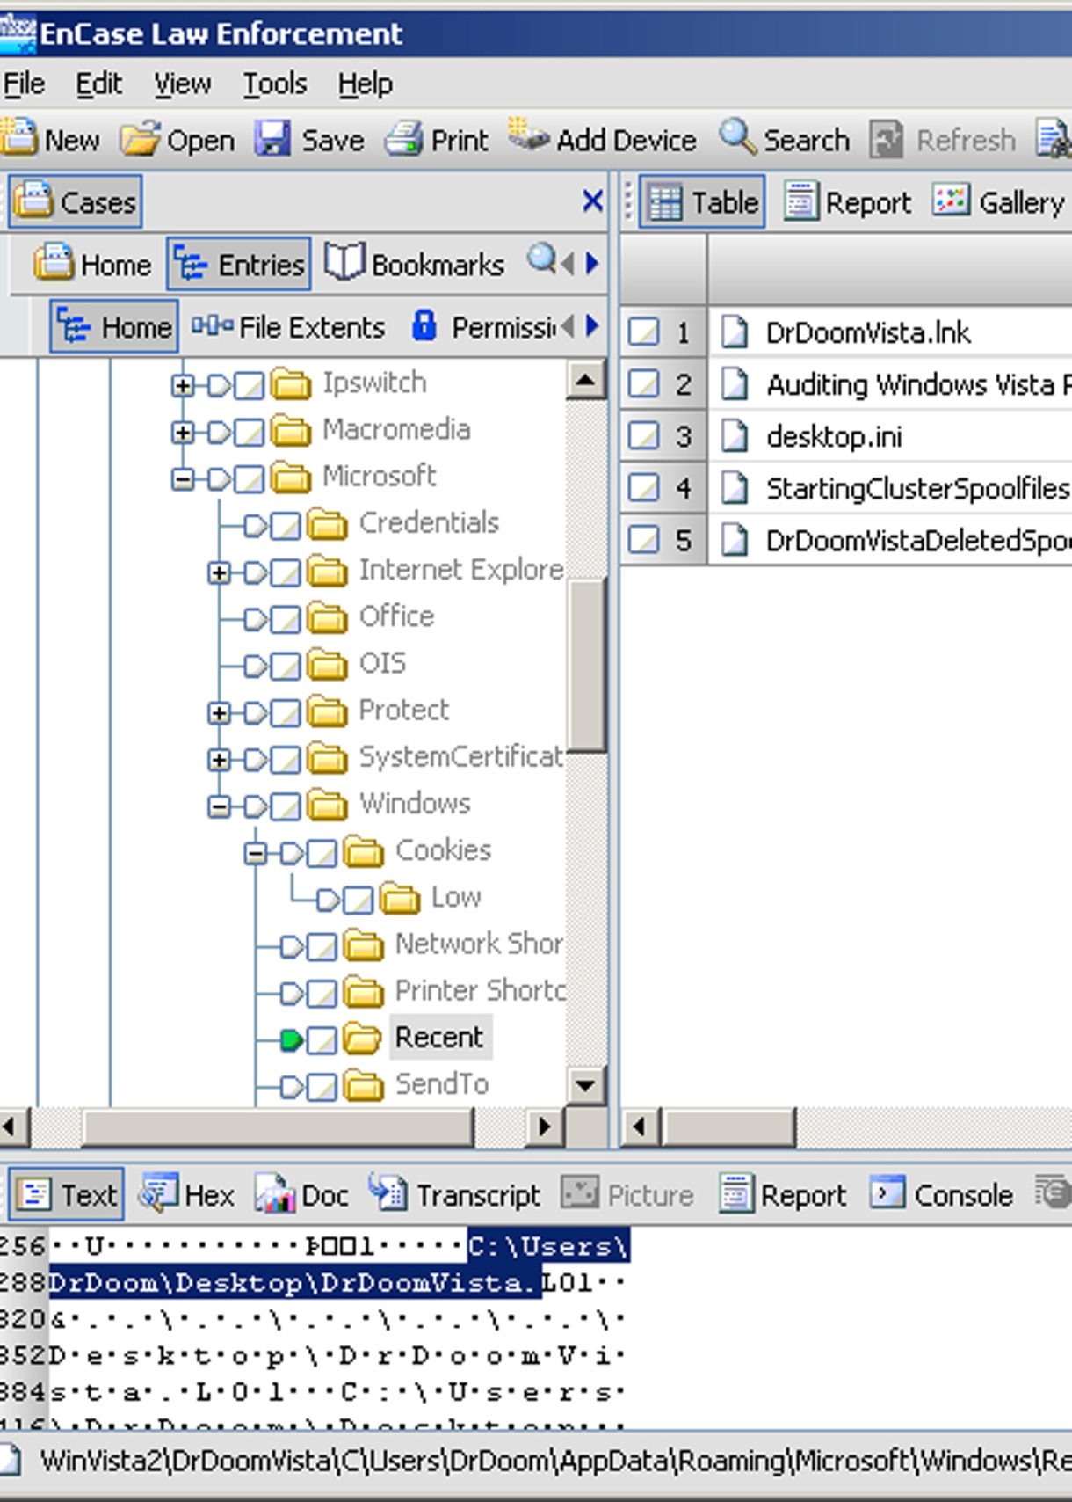
LNK file
Recent folder
Shows that this file has been on the Desktop

Slide 36
Introduced in Windows 7 – Jump Lists
Every app has a start menu – Jump list
Combines
Recent files and recent web sites
Application created custom lists
Jump lists appear in the Start Menu and on the Taskbar
Users can “pin” a program to the Taskbar
Right click the application icon and select Pin the program to the Taskbar
On by default – can be disabled (goto Properties – Start Menu)
All MS programs have Jump Lists
Designed to make it easier for the user to locate (recent) APIs included in Windows

Slide 37
The list for pinned programs is stored in:-
User\username\AppData\Roaming\Microsoft\
InternetExplorer\Quick Launch\User Pinned\Taskbar
Jump Lists are contained in files with an MS extension
These can include AutomaticDestinations and Custom Destinations
Each MS file contains a list of files in the Jump List
If a program is on the Desktop it will not appear in the Jump List
When the Jump lists are disabled, the folder contents are cleared but not wiped
Notes:
The Destination List automatically populates based on how frequently and how recently an application is used. Applications can include tasks, such as composing an email or monitor destination usage.
AutomaticalDestinations folder contains small databases responsible for the recent items on the Jump List. Every program that utilises the Jump List feature will have entries for recorded shortcut containers stored in the AutomaticalDestinations folder. File naming conventions consist of 16 hex values associated with the MS application ID (AppID) which are used to identify programs followed by the phrase “AutomaticalDestinations-ms”
Default is 15 entries but the user can change this number. When the Jump lists are disabled, the folder contents are cleared but not wiped.
The DestLists lists the entries of LNK files stored in the container as well as the machine name the link file points to. The AutomaticDestinations file is parsed by FTK.
Root\Users\username\AppData\Roaming\Microsoft\Windows\Recent\AutomaticDestinations\9b9cdc69c1c24e2b.automaticDestinations-ms
Recent directory – CustomDestinations allows the user to set params for specific application behaviour
E.g. In-Private feature in IE
root/Users/username/AppData/Roaming/Microsoft/Windows/Recent/CustomDestinations/28c8b86deab549a1.customDestinations-ms
Allows users to pin items to the Taskbar
The DestList contains lists of entries of LNK files stored
To see which programs have been pinned to the taskbar, look in registry

Slide 38
Temp folder
Specific to a user
Contains backup copies of files
Programs write temp install files
Normally hidden from the user
Removing a prog from Program files often leaves files and folders in Temp
Use it to refute the claim that a user never had a particular application on their PC
Notes:
Temp folder
Found in Local settings > Temp
Programmes create working copies of open documents, which are not always removed when the doc is closed.
Contains
Backup copies of files
Progs write temp install files and folders
Normally hidden form the user
Uses often remove a program from Program files but may miss the files and folders in Temp
Can be used to refute the claim that a user never had a particular application on their PC

Slide 39
Favorites Folder
Contains Internet shortcut files for MS IE
By default – some are preinstalled
Similar to link files
has information about the target
user accesses target
file ext in .URL
Each URL file has a unique header
User driven
Notes:
Favorites Folder
Contains Internet shortcut files for MS IE
Similar to link files – has info about target
- user accesses to target
- file ext in .url (typically a web site)
The URL file has a unique header [Internet Shortcut] which contains the path to the URL target
Can use this header to search for deleted shortcuts
There are often default Internet shortcut files – MSN, MS etc
User driven
Can have web sites trail – well defined structure to search through
Valuable area to examine – corroborates other findings
Can be used to refute the claim that the user visits were accidental.

Slide 40
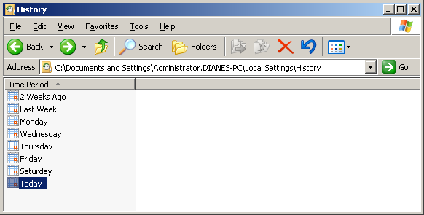
History Folder
Can go back and see the web sites that they visited
Can view History File from IE (History Button)
Index.dat is in each folder

Slide 41
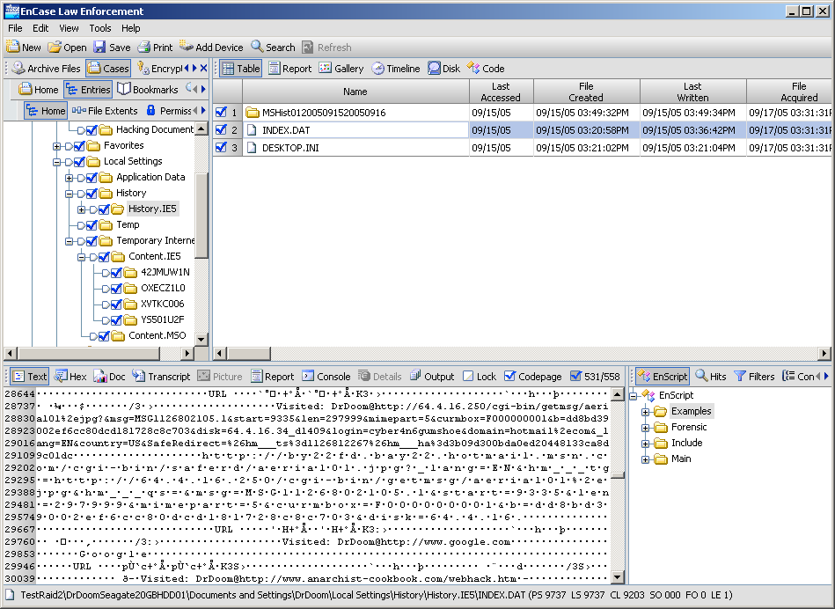

Slide 42
Temporary Internet Files
Stores files downloaded and cached
If files are current then browser does not need to get new copies
Uses index.dat
In Content.IE5 folder there are at least 4 folders
Heavy browsers could have up to 20 folders
Each web page consists of many files
Changes name – e.g. bluespotted.jpg will be saved as bluespotted[1].jpg
Notes:
Temporary Internet Files
A typical web page consists of many files, typically a dozen or more. Downloaded from the web site, they are written to cache files.
The name will be modified slightly – i.e. [1] or [2] will be added to the filename
Index.dat keeps track of these file name changes. Each file in cache has an entry in the index.dat.
The Temporary Internet Files can also be used by other programmes. The folder OLK is often found if Outlook is used. Outlook opens attachments in this folder – which is excellent for a forensic investigator. Users often assume that saved stuff is in My Documents and look there to delete files.
Outlook Express also opens attachments directly in the cache folders.

Slide 43
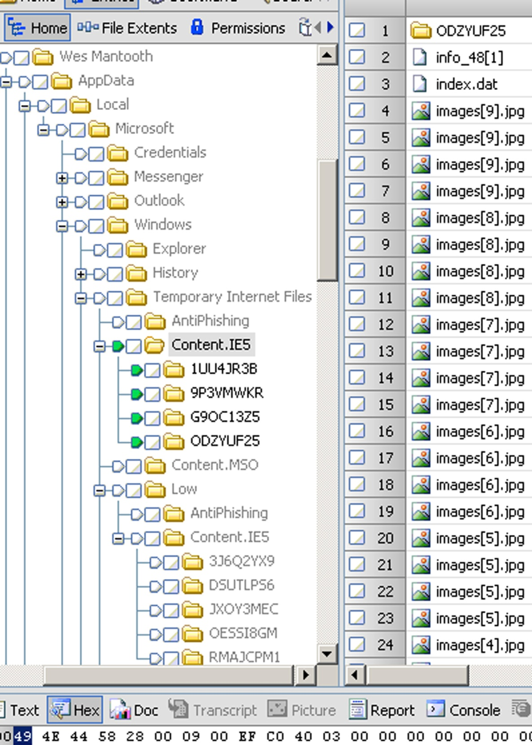
Windows 7
User\username\AppData\Local\Microsoft\Windows\Temporary Internet Files
Highlighted with green “Set Include”

Slide 44
Thumbnails - XP
Used to quickly view large numbers of graphics
Created in the folder where the pictures are located
Small database - Thumbs.db
Windows stores jpg, bmp, gif and htm as thumbnails
Stored as a small jpg
Changed with Windows 7 and Vista
Now called Thumbcache
Stored in
User\username\AppData\Local\Microsoft\Windows\Explorer
Notes:
Ref: Hurlbut, D. Thumbs DB Files Forensic Issues, Access Data Training

Slide 45
Could be hidden – why?
If a picture file is deleted what happens to the thumbs.db?
What happens if the folder is renamed?
What happens if they delete the folder?
What is displayed if the file is not a graphic?
How can we get rid of the thumbs.db?
Can you stop the thumbs.db being created?
Click on Thumbs.db to see info

Slide 46
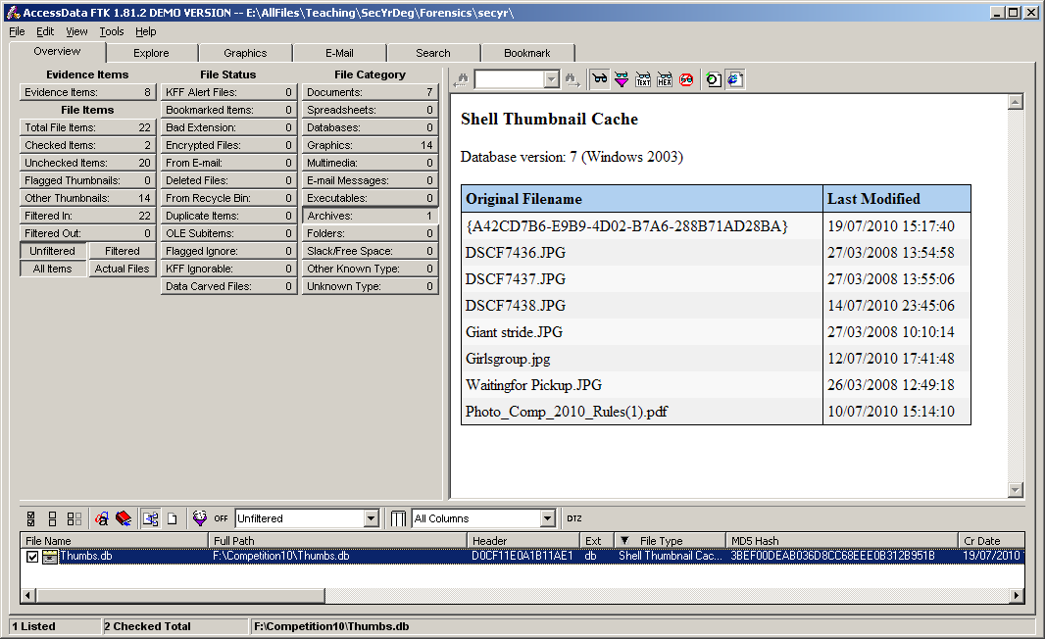

Slide 47
Forensics Importance
Potential to provide collaborative evidence
User may delete files but Thumbs.db is a system file
May get left behind
In Windows 7
No longer with the parent files
Thumbcache is directly tied to the user
Folder contains 6 files
2 administrative
4 to store Thumbnail files

Slide 48
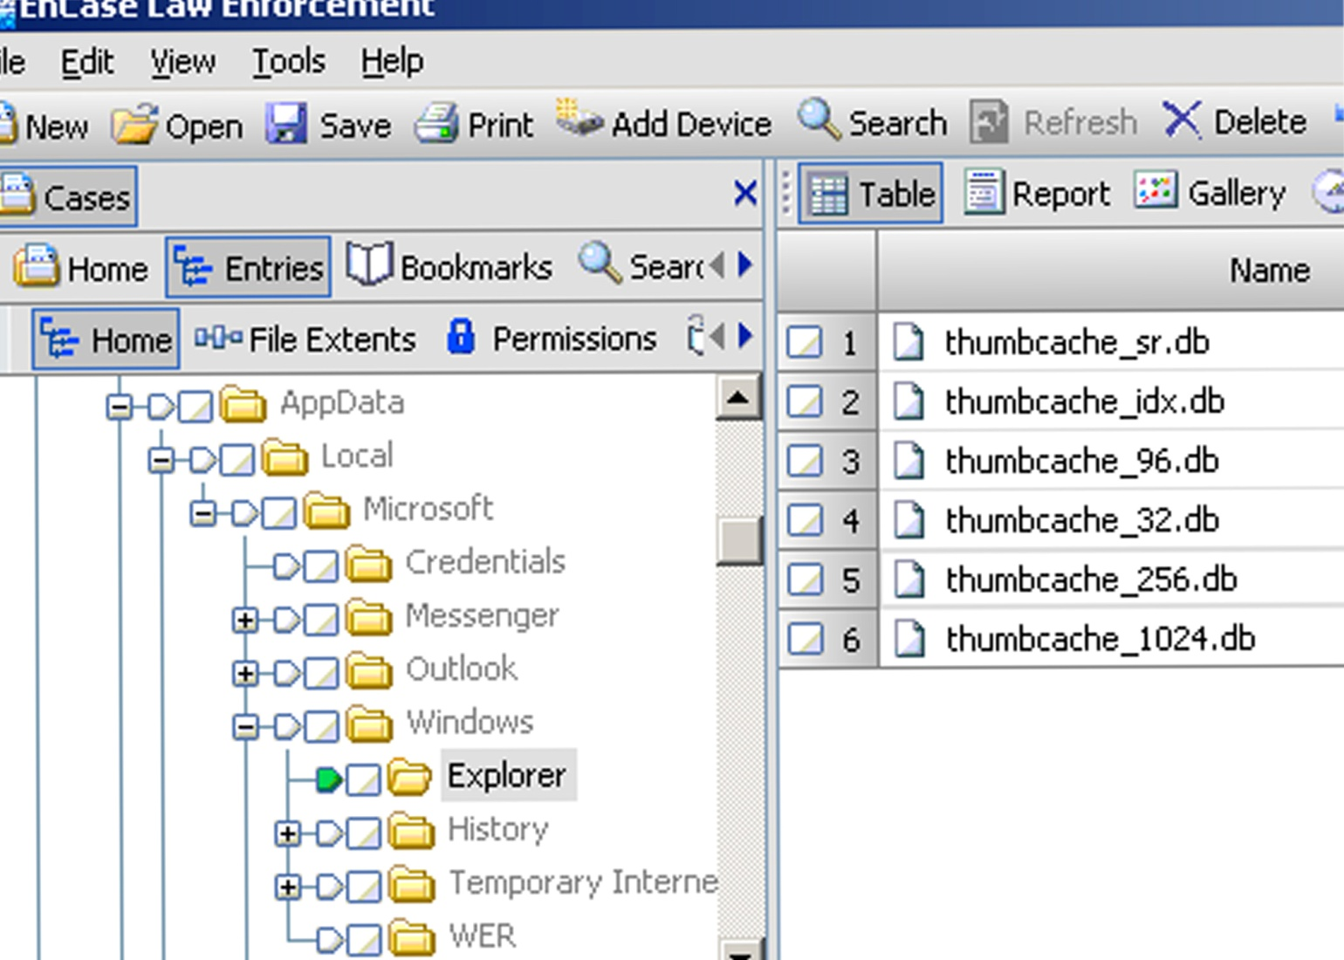
Thumbcache_1024.db
Thumbcache_256.db
Thumbcache_96.db
Thumbcache_32.db
Not just for graphic files
Thumbcache_###.db uses a standard format for tracking

Slide 49
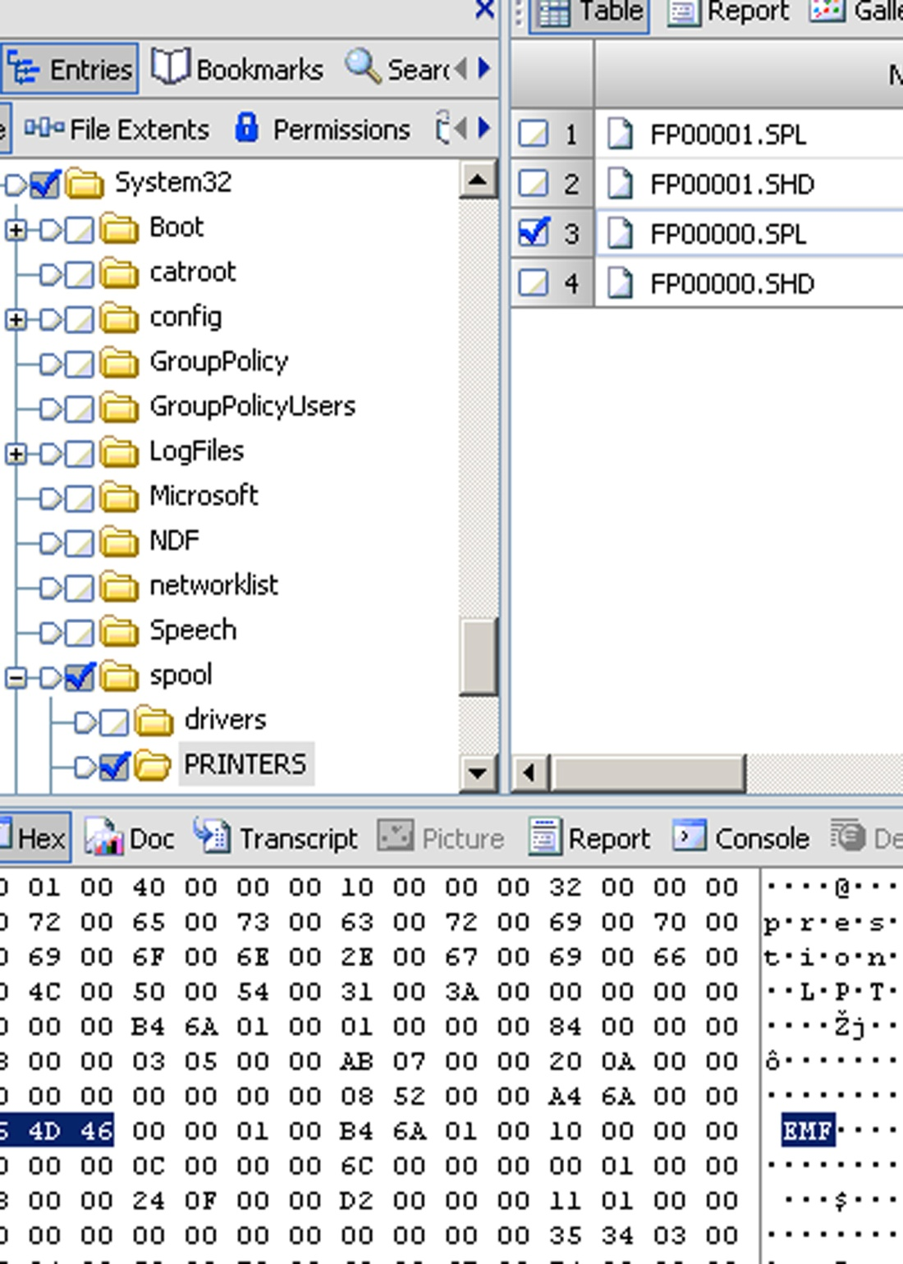
Print Spooling – Windows 7
Spool files – .SPL
No change from Vista
Contains .EMF graphic file for each page printed
\Windows\System32\Printer\Spool

Slide 50
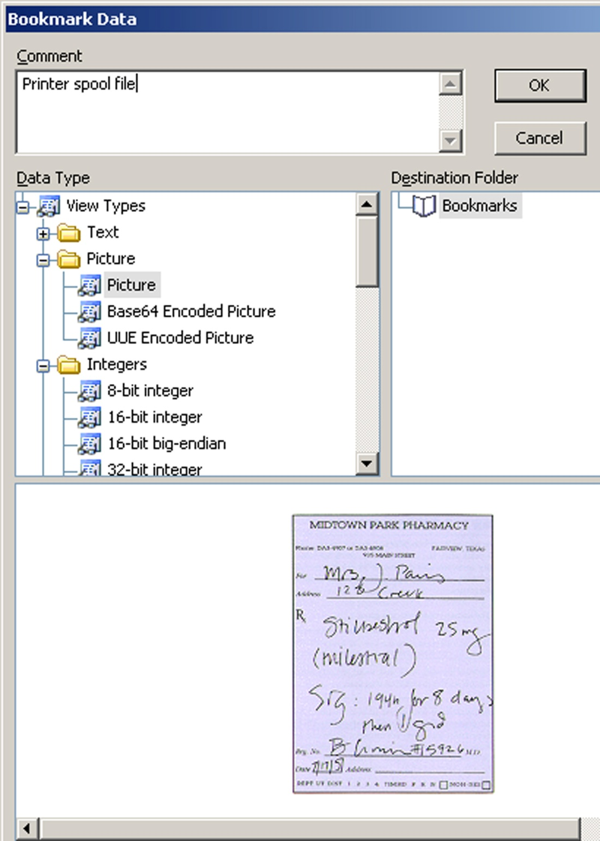
Find the .EMF graphic file
Sweep back 44 bytes
Bookmark as a picture
\Windows\System32\Printer\Spool

Slide 51
Swap files
Correctly called - page file
Limited supply of RAM
Purpose is to cache RAM memory
Hibernation file
Contents of RAM are written to a file
Hiberfil.sys – located in the root of the system drive
Even if unused, it will still be the same size as the systems RAM (00h)

Slide 52
Windows 7 file locations
Cookies
User\username\AppData\Roaming\Microsoft\Windows\Cookies
Send To
User\username\AppData\Roaming\Microsoft\Windows\SendTo
Recent
User\username\AppData\Roaming\Microsoft\Windows\Recent
History
User\username\AppData\Local\Microsoft\Windows\History
Temporary Internet Files
User\username\AppData\Local\Microsoft\Windows\Temporary Internet Files
Favorites
User\username\Favorites

Slide 53
Conclusion
Artifacts
User location – no longer in Documents and Settings
Shadow copy
Thumbscache
File system
$Recycle.bin
System related registry
Link files
Spool files (.spl)– minor change to .shd file
Jump lists

